Slide 1
Mining Massive Datasets
Shannon Quinn
(with thanks to William Cohen of Carnegie Mellon and Jure Leskovec of Stanford)

Slide 2



“Big Data”

Slide 3
The four V’s of Big Data
Volume
Velocity
Variety
Veracity (messiness)

Slide 4

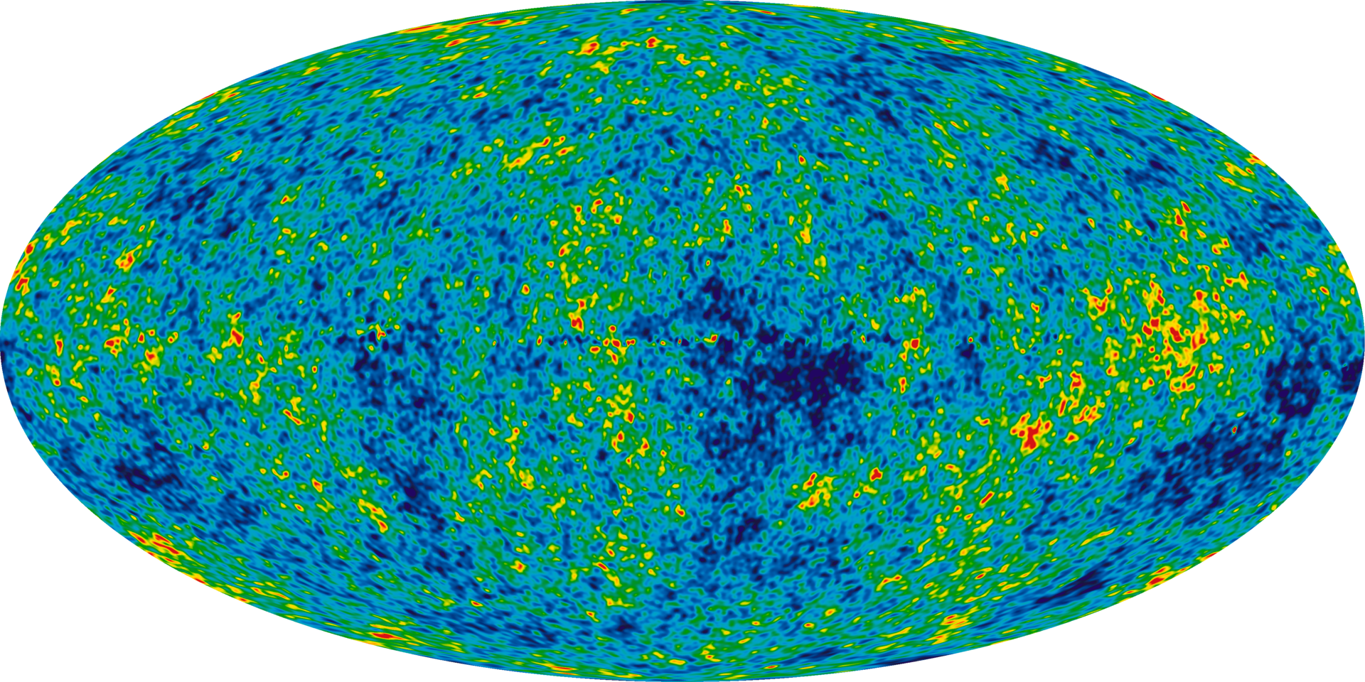
Astronomy
Sloan Digital Sky Survey
New Mexico, 2000
140TB over 10 years
Large Synoptic Survey Telescope
Chile, 2016
Will acquire 140TB every five days¹
1 http://www.economist.com/node/15557443

Slide 5
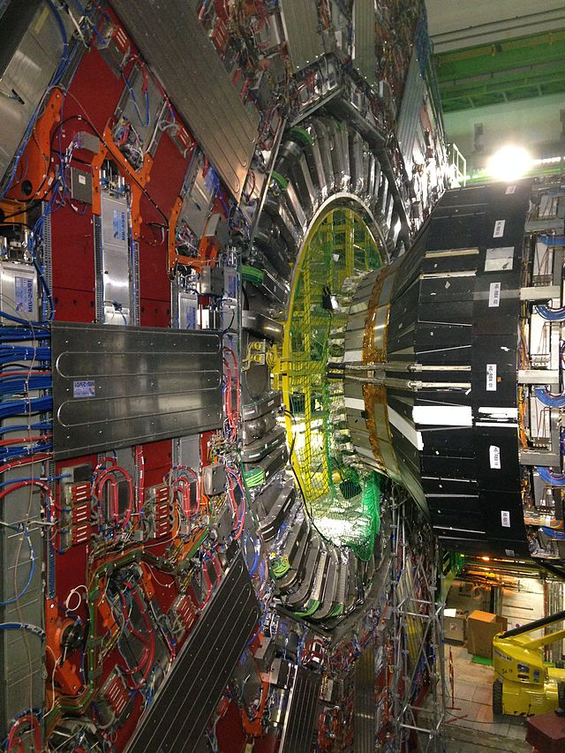
Particle Physics
Large Hadron Collider (LHC)
150 million sensors
40 million data points / second (before filtering)
100 collisions of interest (after filtering)¹
Even after rejecting 199,999 of every 200,000 collisions, generates 15PB of data per year^{1,2}
If all collisions were recorded, LHC would generate 500EB of data per day
~900EB transmitted over IP per year³
1 http://cds.cern.ch/record/1092437/files/CERN-Brochure-2008-001-Eng.pdf
2 http://www.nature.com/news/2011/110119/full/469282a.html
3 http://www.cisco.com/en/US/solutions/collateral/ns341/ns525/ns537/ns705/ns827/VNI_Hyperconnectivity_WP.html

Slide 6
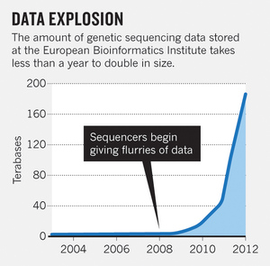
Biology
Nucleotide sequences from 120,000+ species in GenBank¹
European Bioinformatics Institute (EBI)
20PB of data (genomic data doubles in size each year)²
A single sequenced human genome can be around 140GB in size²
Heterogeneous data, spread out over many labs
1 http://www.nature.com/nature/journal/v455/n7209/full/455047a.html
2 http://www.nature.com/nature/journal/v498/n7453/full/498255a.html

Slide 7
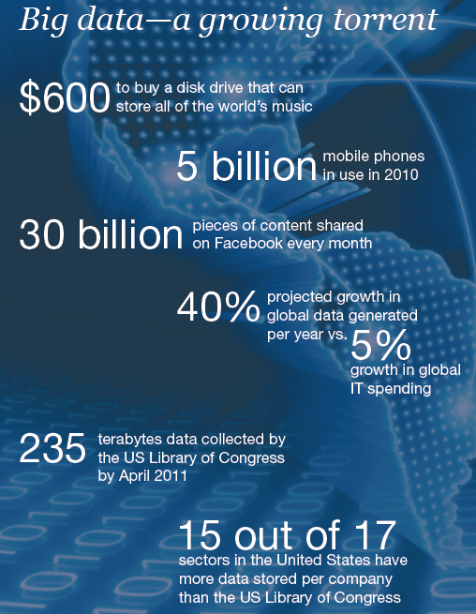
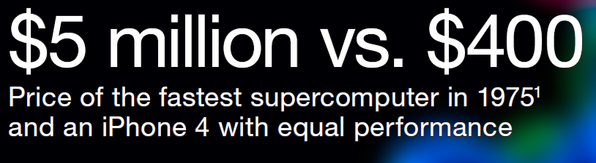

Slide 8

Data Mining
Knowledge discovery
“Big Data”
“Predictive Analysis”
“Data Science”

Slide 9
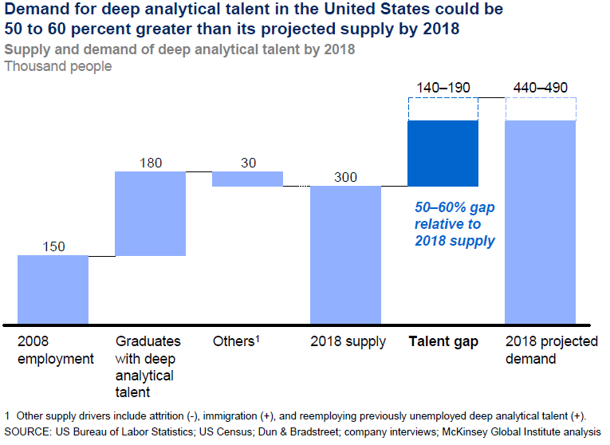
Data Scientists in demand

Slide 10
Why is large-scale data mining a thing?
Why not use the same algorithms on larger data?

Slide 11
So in mid 1990’s…..
Experimental datasets were small
Many commonly used algorithms were asymptotically “slow”

Slide 12
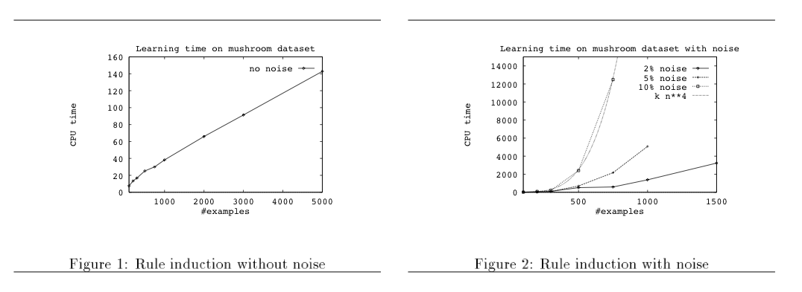
Big ML c. 1993 (Cohen, “Efficient…Rule Learning”, IJCAI 1993)

Slide 13
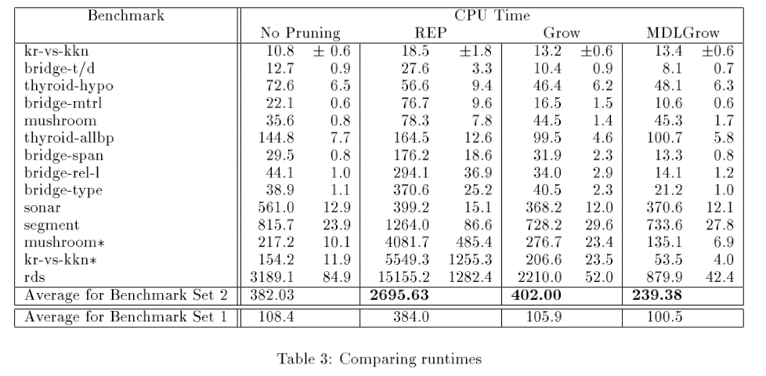

Slide 14
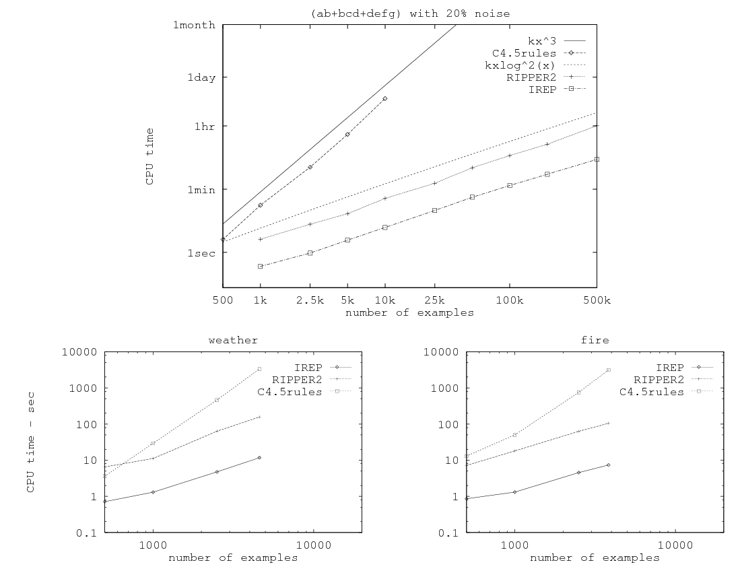
Related paper from 1995…

Slide 15
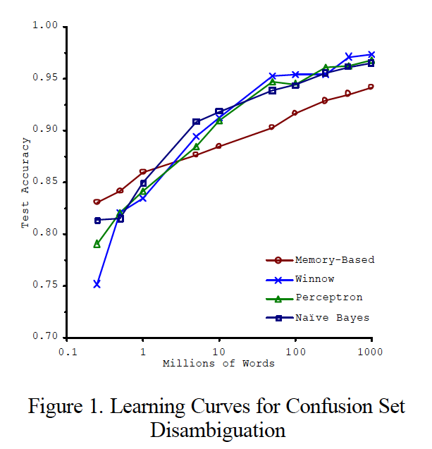
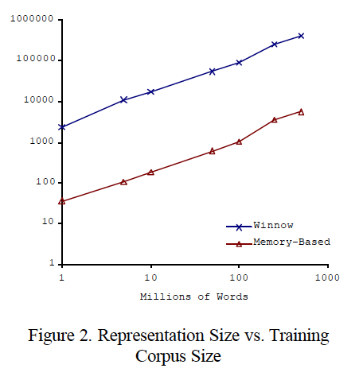
Big ML c. 2001 (Banko & Brill, “Scaling to Very Very Large…”, ACL 2001)
Task: distinguish pairs of easily-confused words (“affect” vs “effect”) in context

Slide 16
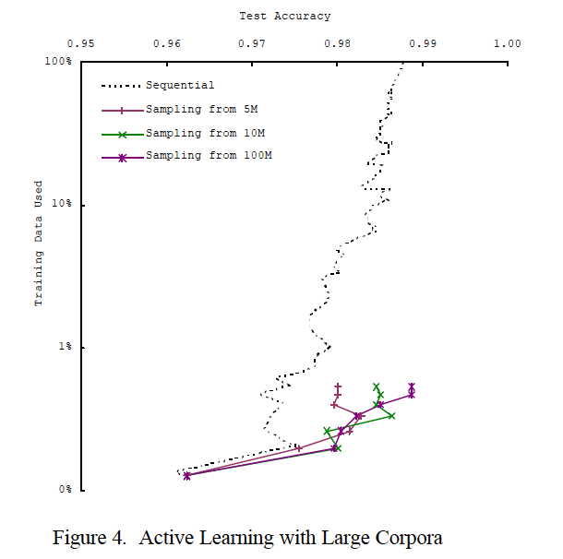
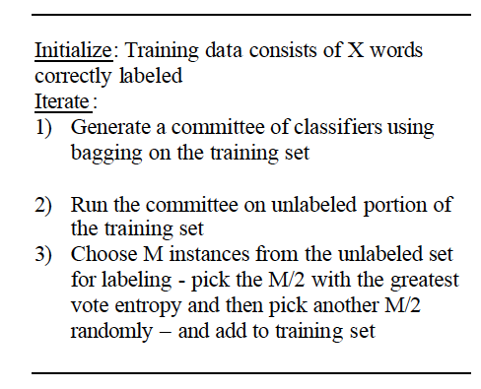
Big ML c. 2001 (Banko & Brill, “Scaling to Very Very Large…”, ACL 2001)

Slide 17
So in 2001…..
We’re learning:
“there’s no data like more data”
For many tasks, there’s no real substitute for using lots of data

Slide 18
…and in 2009
Eugene Wigner’s article “The Unreasonable Effectiveness of Mathematics in the Natural Sciences” examines why so much of physics can be neatly explained with simple mathematical formulas such as f = ma or e = mc². Meanwhile, sciences that involve human beings rather than elementary particles have proven more resistant to elegant mathematics. Economists suffer from physics envy over their inability to neatly model human behavior. An informal, incomplete grammar of the English language runs over 1,700 pages.
Perhaps when it comes to natural language processing and related fields, we’re doomed to complex theories that will never have the elegance of physics equations. But if that’s so, we should stop acting as if our goal is to author extremely elegant theories, and instead embrace complexity and make use of the best ally we have: the unreasonable effectiveness of data.
Norvig, Pereira, Halevy, “The Unreasonable Effectiveness of Data”, 2009

Slide 19

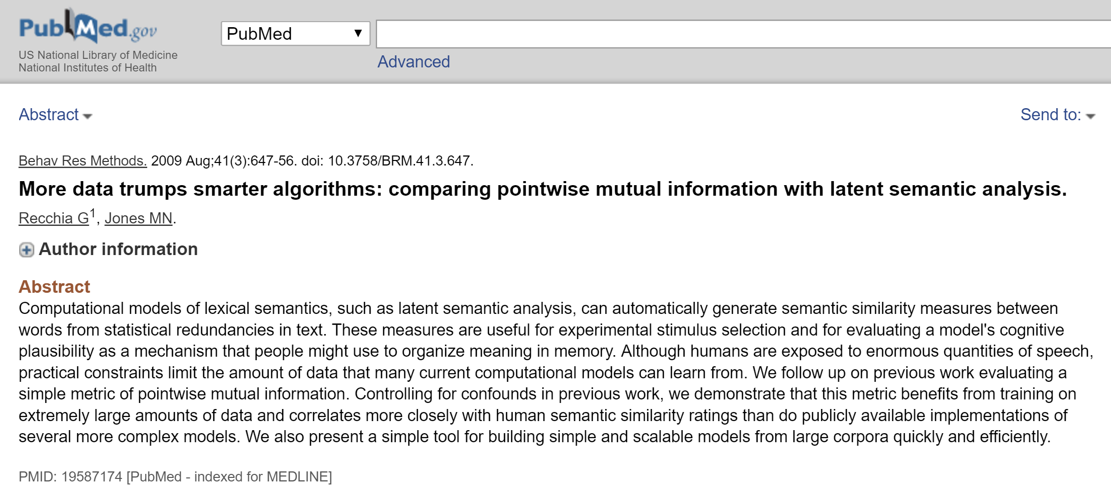
More Data smarter algorithms

Slide 20
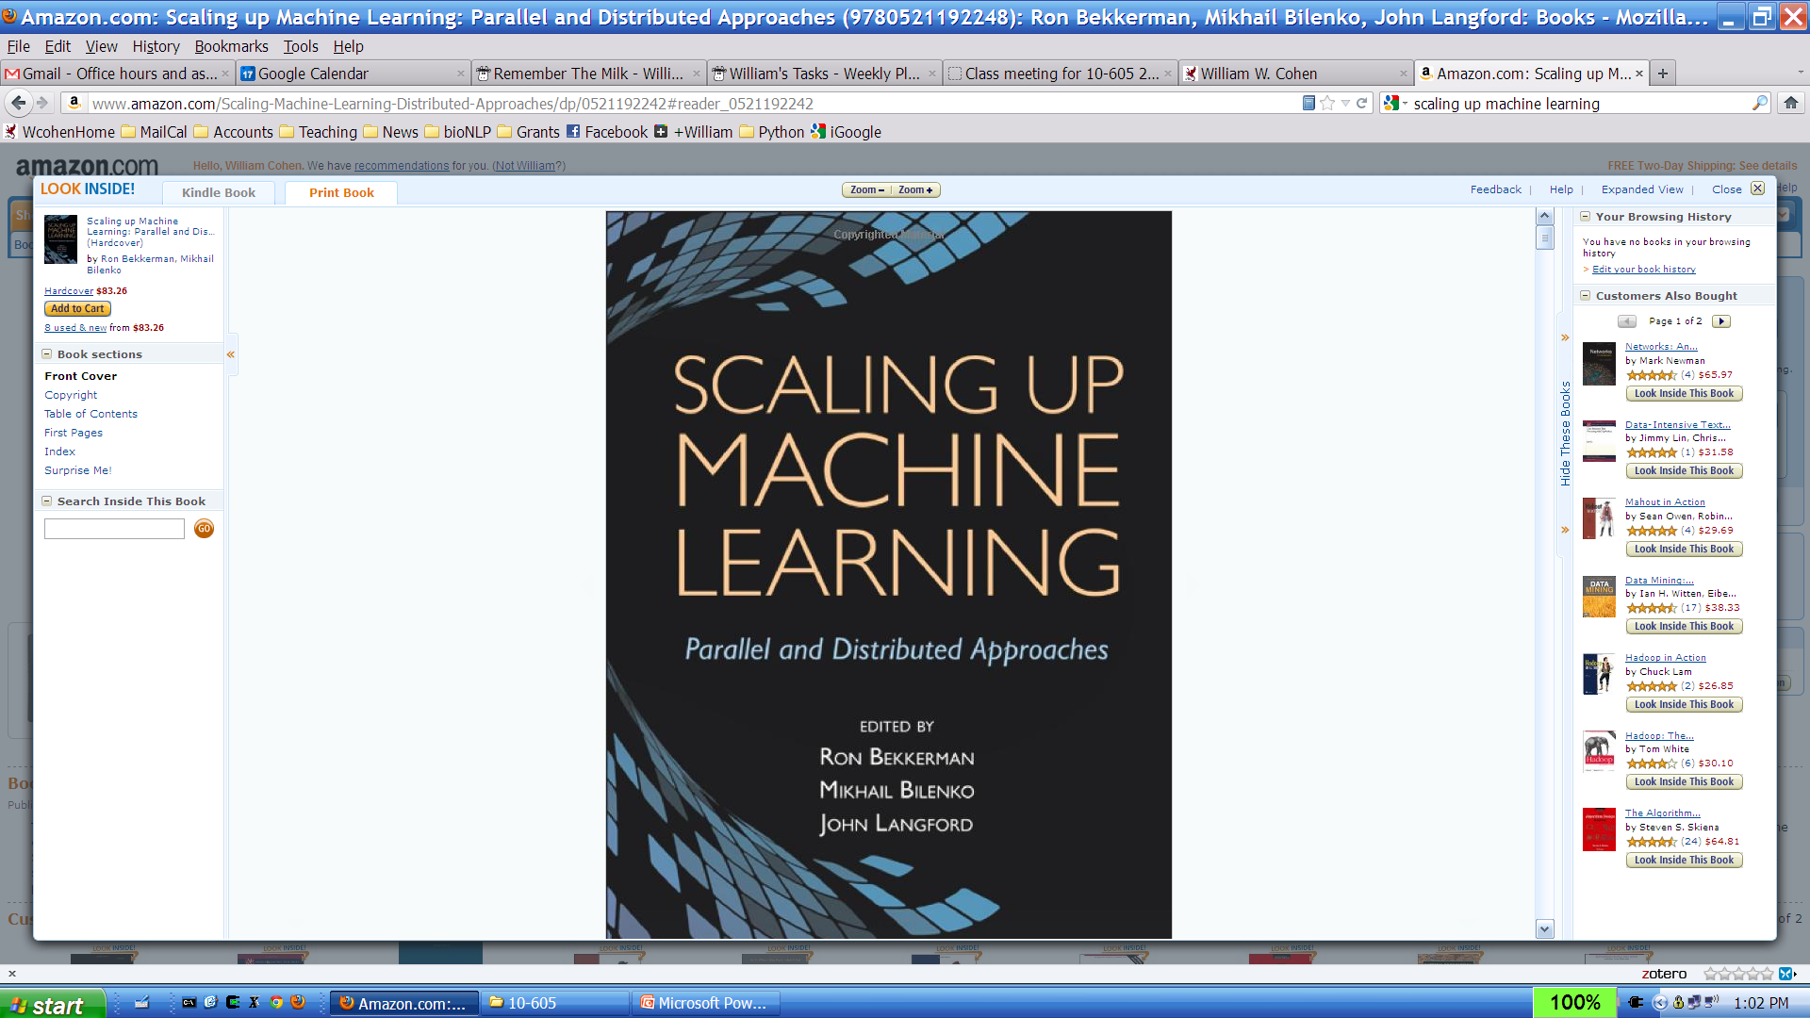
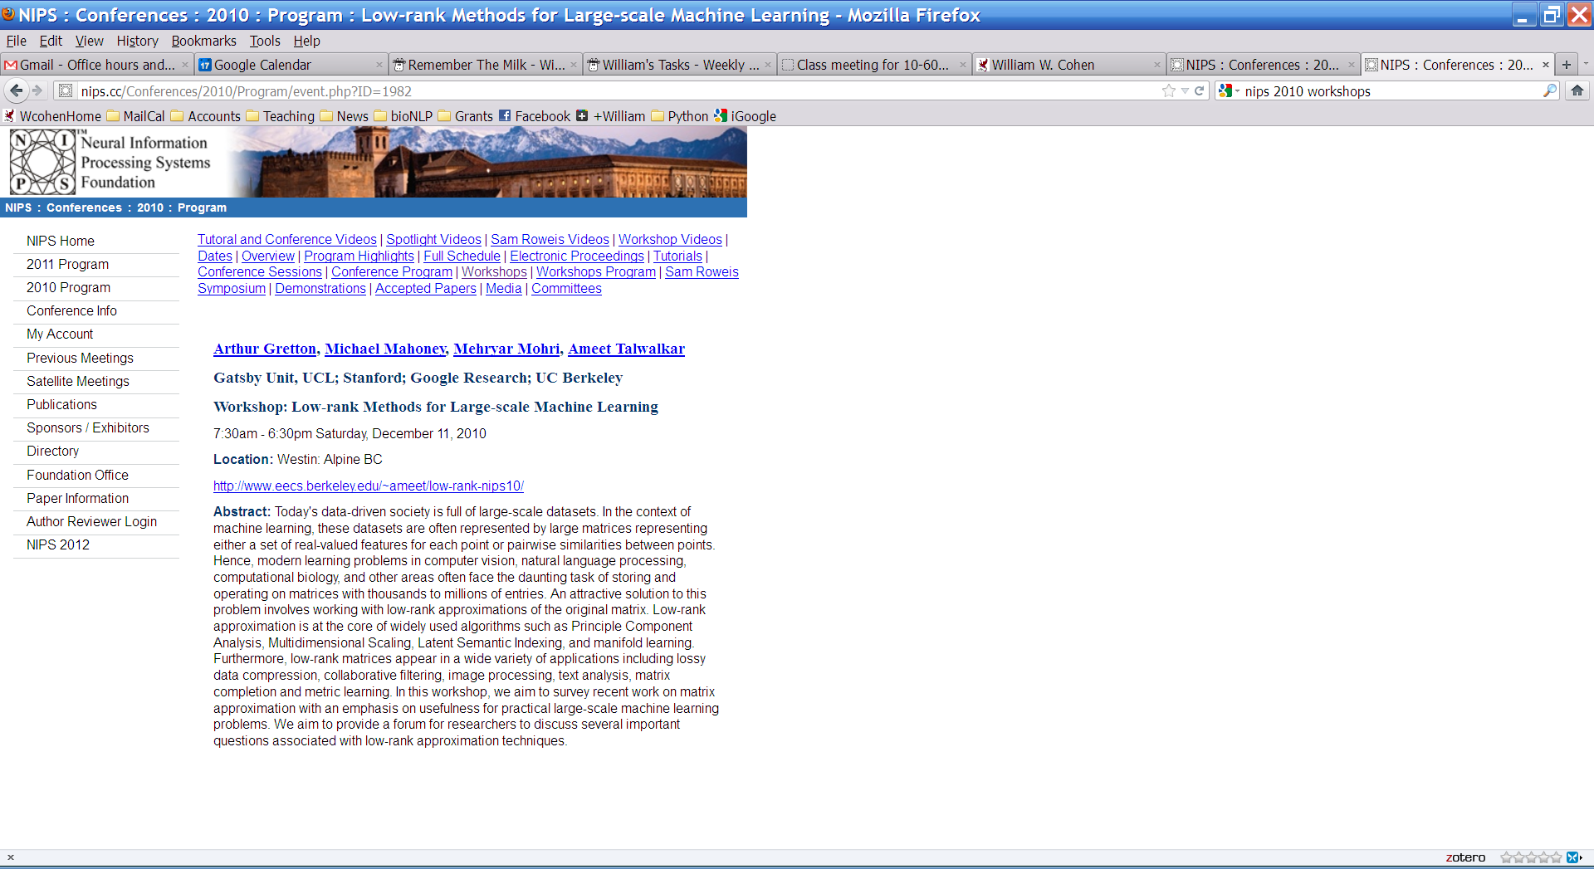
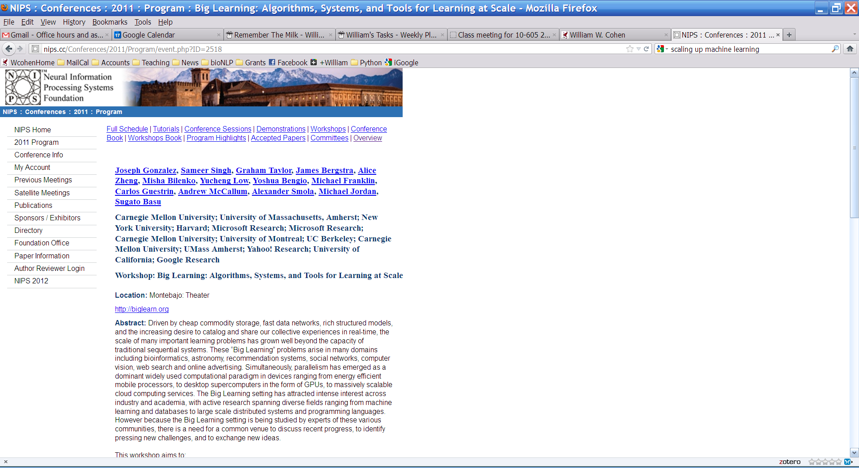

…and in 2012
Dec 2011

Slide 21
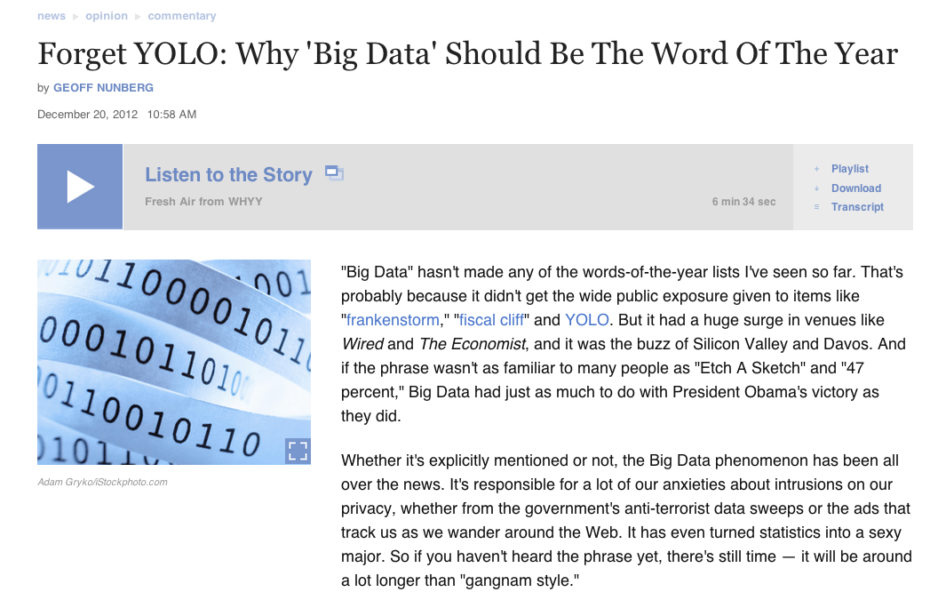
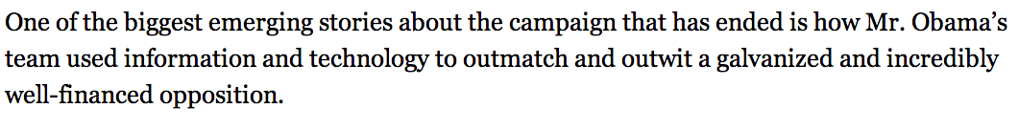

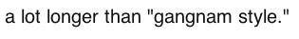
…and in 2013

Slide 22




…and in 2014

Slide 23
How do we use very large amounts of data?
*
Working with big data is not about
code optimization
learning details of todays hardware/software:
GraphLab, Hadoop, parallel hardware, ….
Working with big data is about
Understanding the cost of what you want to do
Understanding what the tools that are available offer
Understanding how much can be accomplished with linear or nearly-linear operations (e.g., sorting, …)
Understanding how to organize your computations so that they effectively use whatever’s fast
Understanding how to test/debug/verify with large data
* according to William Cohen / Shannon Quinn

Slide 24
Empirical analysis of complexity: plot run-time on a log-log plot and measure the slope (using linear regression)

Slide 25
ML on Big Data

Slide 26
Examples
Recommendation
Linear SVM
Spectral Decomposition

Slide 27
Recommendations
One of the very popular problems in big data
Eg, users and movies/books/..etc
Multiple approaches (Item-profiling, user-user, latent factors ..etc)
Each with own pros and cons

Slide 28
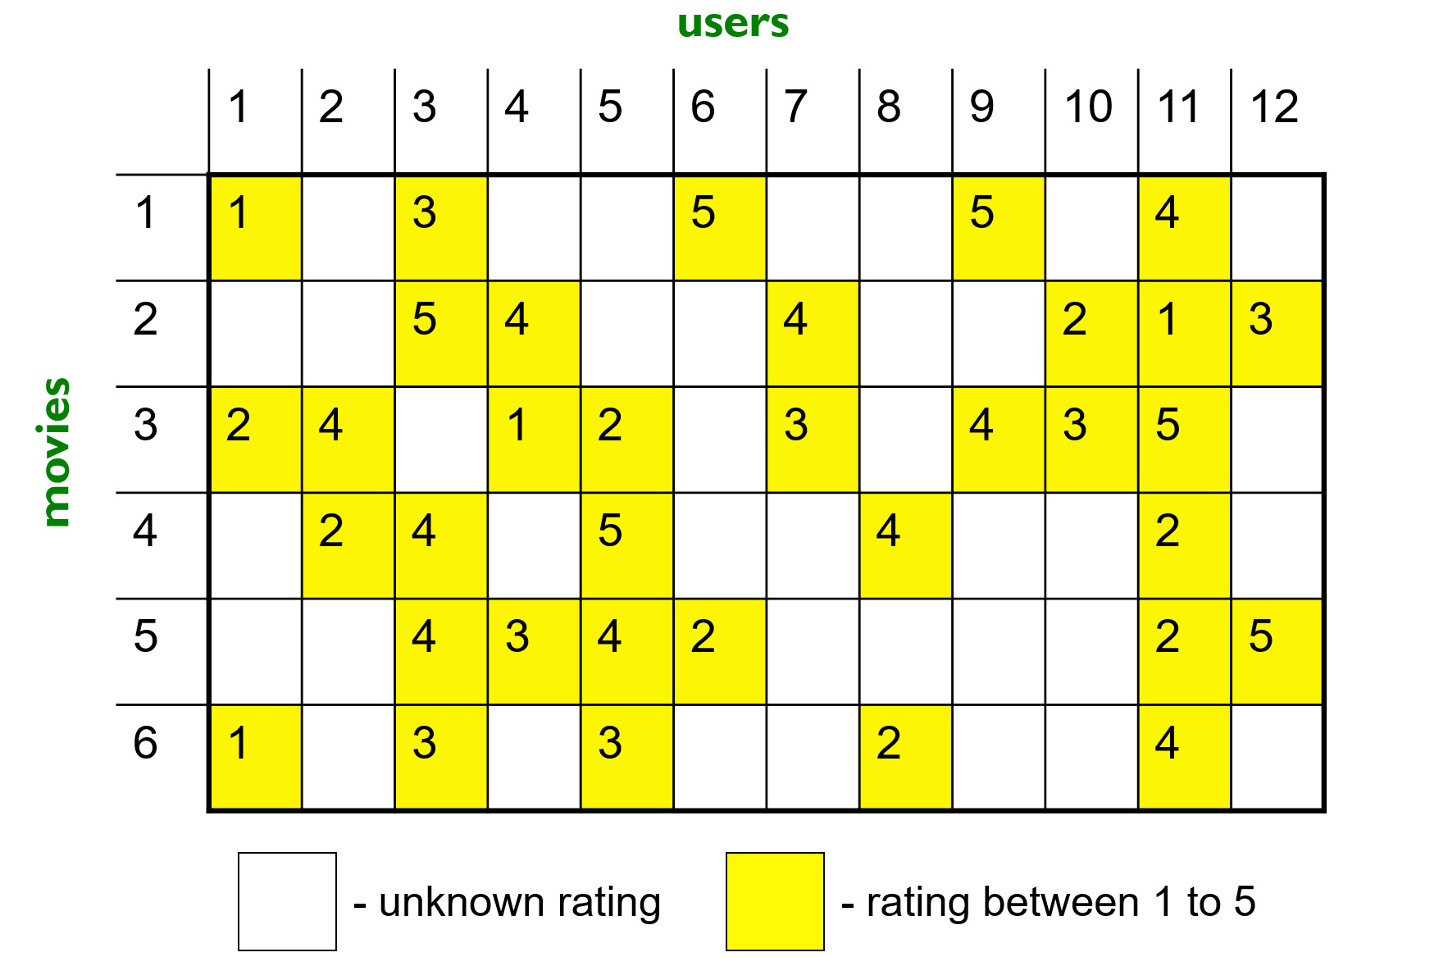
Latent factor model for recommendation
Imagine a rating matrix:

Slide 29
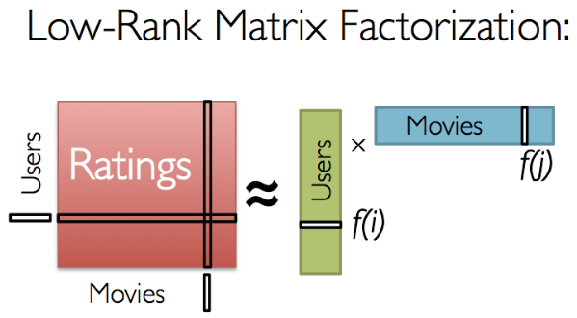
Latent factors model for recommendation
n
n
r
m
m
r

Slide 30
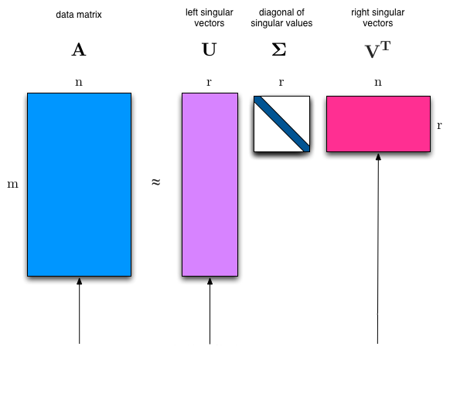
SVD ?
Rating Matrix
Users Matrix
Movies Matrix

Slide 31
Problems of SVD
O(mn²) “cubic in data”
Shoots for minimum least square error assuming zero-ratings for non-specified user-movie pairs
Even for sparse solvers.
Workaround: Use cosine similarity on the reduced dimensions (r) to find other user’s rating of the movie
Not accurate enough

Slide 32
Solution to big data recommender systems
The data does not reside in one place
Methods:
Alternating least squares
Stochastic Gradient Descent

Slide 33
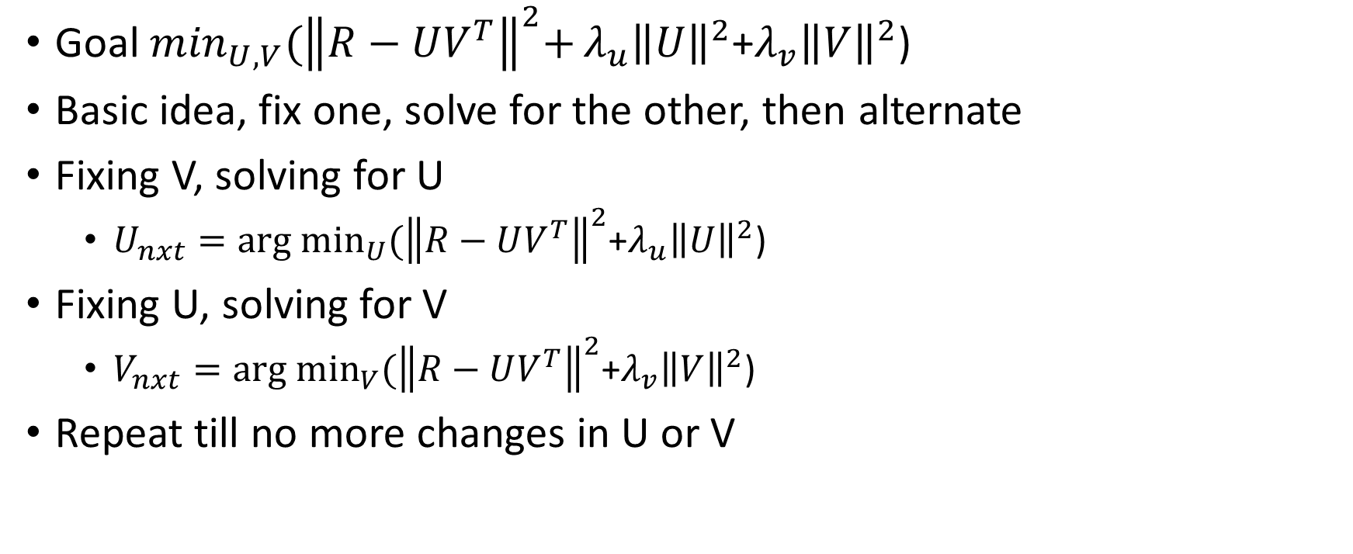
Alternating Least Square^{[6]}
Goal $\min_{U,V}{{(\left\|R−UV^{T}\right\|}^{2}+}{λ_{u}\left\|U\right\|}^{2}$+${λ_{v}\left\|V\right\|}^{2}$)
Basic idea, fix one, solve for the other, then alternate
Fixing V, solving for U
$U_{nxt}={arg min}_{U}{(\left\|R−UV^{T}\right\|}^{2}\text{+}{λ_{u}\left\|U\right\|}^{2}\text{)}$
Fixing U, solving for V
$V_{nxt}={arg min}_{V}{(\left\|R−UV^{T}\right\|}^{2}\text{+}{λ_{v}\left\|V\right\|}^{2}$)
Repeat till no more changes in U or V

Slide 34
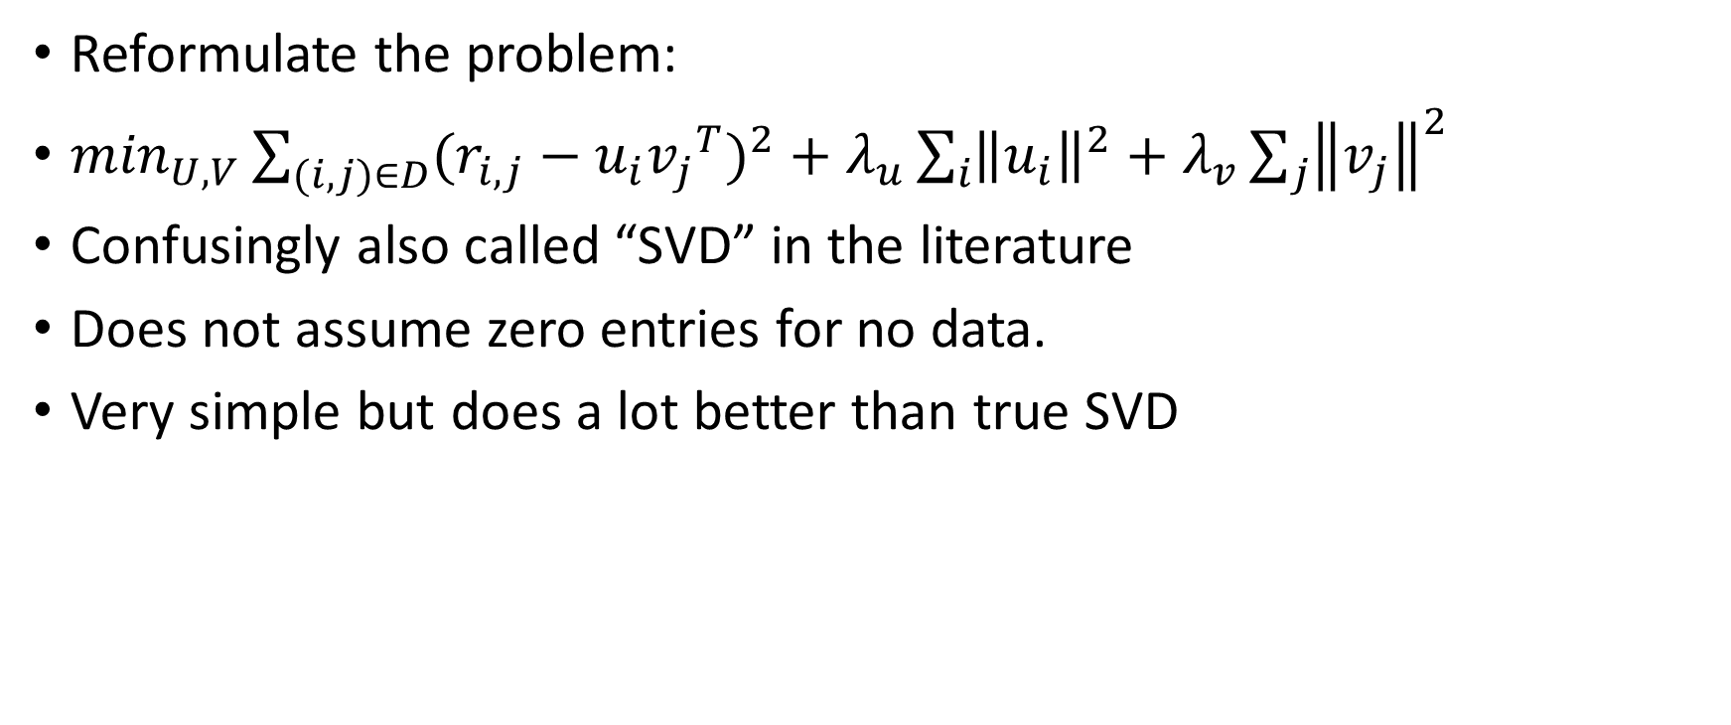
Latent factors model (simple model)
Reformulate the problem:
$\min_{U,V}{\sum_{(i,j)∈D}{{(r_{i,j}−{u_{i}v_{j}}^{T})}^{2}}+λ_{u}\sum_{i}{{\left\|u_{i}\right\|}^{2}}+λ_{v}\sum_{j}{{\left\|v_{j}\right\|}^{2}}}$
Confusingly also called “SVD” in the literature
Does not assume zero entries for no data.
Very simple but does a lot better than true SVD
R
U
V^{T}
r
m
m
n
r
n
r

Slide 35
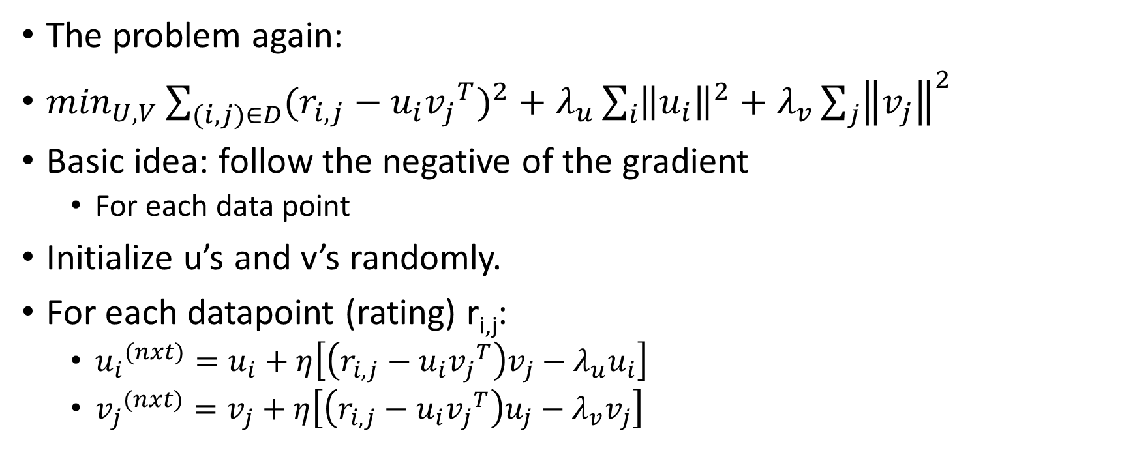
Stochastic Gradient Descent
The problem again:
$\min_{U,V}{\sum_{(i,j)∈D}{{(r_{i,j}−{u_{i}v_{j}}^{T})}^{2}}+λ_{u}\sum_{i}{{\left\|u_{i}\right\|}^{2}}+λ_{v}\sum_{j}{{\left\|v_{j}\right\|}^{2}}}$
Basic idea: follow the negative of the gradient
For each data point
Initialize u’s and v’s randomly.
For each datapoint (rating) r_{i,j}:
${u_{i}}^{(nxt)}=u_{i}+η\left[\left(r_{i,j}−{u_{i}v_{j}}^{T}\right)v_{j}−λ_{u}u_{i}\right]$
${v_{j}}^{(nxt)}=v_{j}+η\left[\left(r_{i,j}−{u_{i}v_{j}}^{T}\right)u_{j}−λ_{v}v_{j}\right]$

Slide 36
SGD in a non-distributed setting
Initialize U and V randomly
Repeat until convergence:
Pick a datapoint r_{i,j} uniformly at random
Update row i of U and column j of V^{T} using the gradient equations

Slide 37
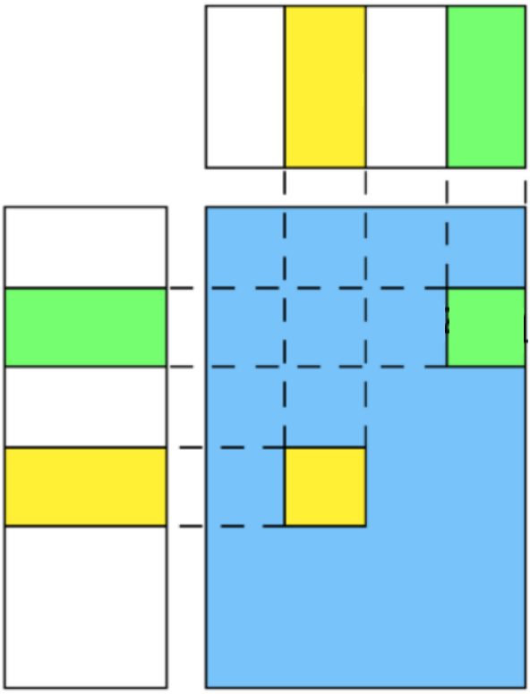
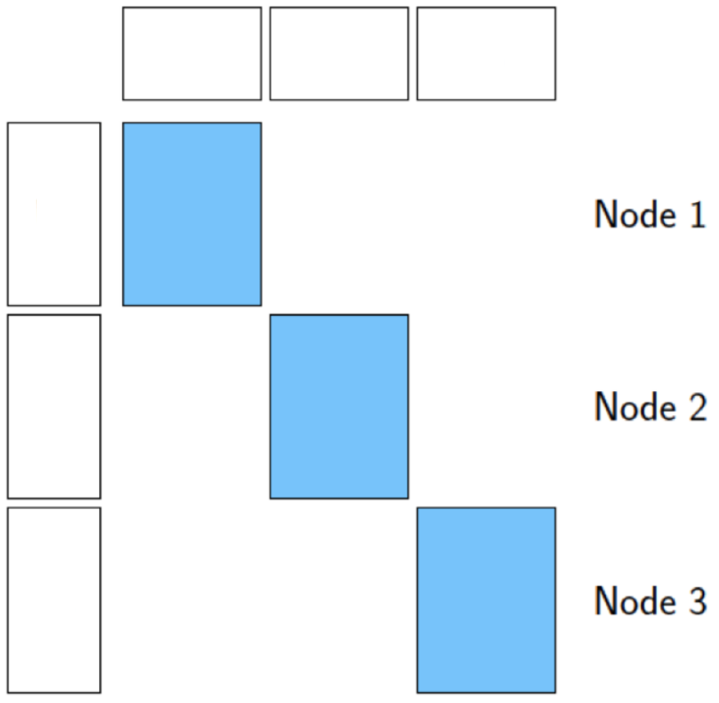
SGD in a distributed setting^{[7]}
Conflict arises if datapoint r_{i,j} and datapoint r_{k,j} reside on different workers
Both compute different updates for v_{j}
Solution:
Have the workers work on non-conflicting regions
V^{T}
U

Slide 38
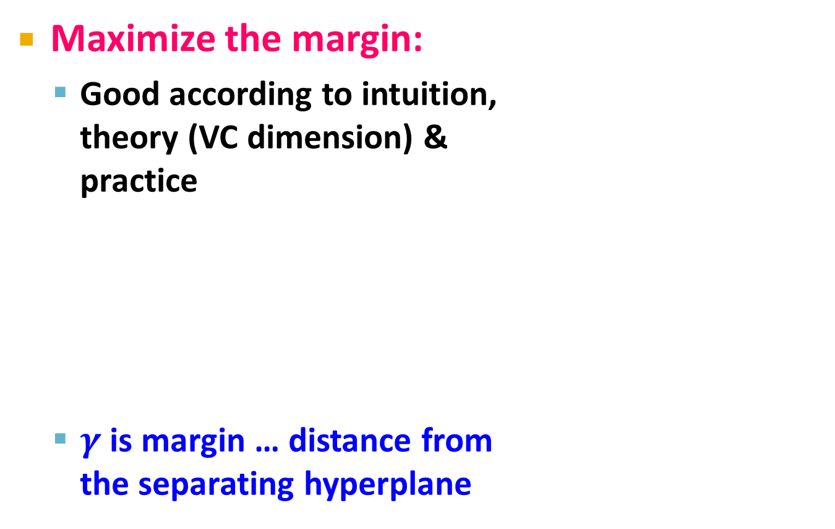
Support Vector Machine
Maximize the margin:
Good according to intuition, theory (VC dimension) & practice
is margin … distance from the separating hyperplane
+
+
w⋅x+b=0
+
+
+
-
+
γ
+
γ
-
-
-
+
γ
-
-
-
Maximizing the margin

Slide 39
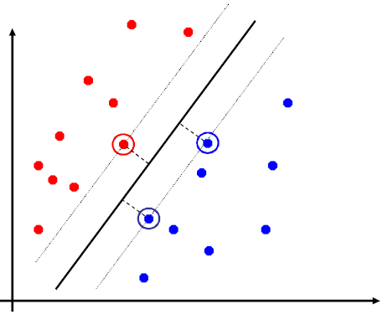
Support Vector Machines
Separating hyperplane is defined by the support vectors
Points on +/- planes from the solution
If you knew these points, you could ignore the rest
Generally, d+1 support vectors (for d dim. data)

Slide 40
Non-linearly Separable Data
If data is not separable introduce penalty:
Minimize ǁwǁ² plus the number of training mistakes
Set C using cross validation
How to penalize mistakes?
All mistakes are not equally bad!
+
+
w⋅x+b=0
+
-
+
+
-
+
-
-
+
-
+
-
-
-
-

Slide 41
Support Vector Machines
Introduce slack variables ξ_{i}
If point x_{i} is on the wrong side of the margin then get penalty ξ_{i}
+
w⋅x+b=0
+
+
-
+
ξ_{i}
+
+
ξ_{j}
-
-
+
+
-
-
-
For each data point:
If margin ≥ 1, don’t care
If margin < 1, pay linear penalty
Notes:
ksi

Slide 42
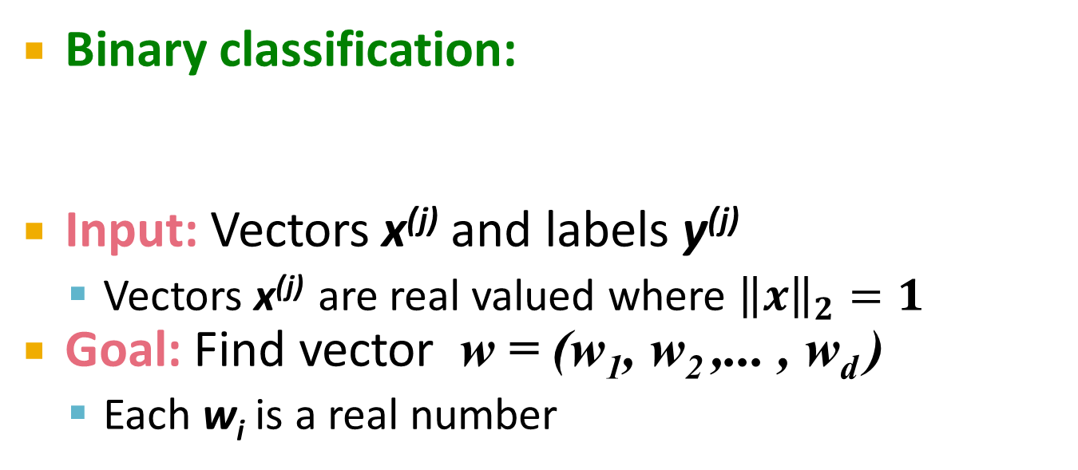
Slack Penalty $C$
What is the role of slack penalty C:
C=∞: Only want to w, b that separate the data
C=0: Can set ξ_{i} to anything, then w=0 (basically ignores the data)
small C
+
“good” C
+
+
+
+
big C
+
-
-
+
+
-
-
-
-
(0,0)

Slide 43
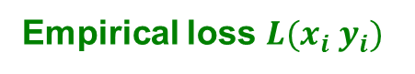
SVM: How to estimate w?
Want to minimize f(w,b):
Compute the gradient ∇(j) w.r.t. w^{(j)}
Empirical loss $L(x_{i} y_{i})$

Slide 44
SVM: How to estimate w?
Gradient descent:
Problem:
Computing ∇f^{(j)} takes O(n) time!
n … size of the training dataset
Iterate until convergence:
For j = 1 … d
Evaluate:
Update: w^{(j)} ← w^{(j)} - η∇f^{(j)}
η…learning rate parameter C… regularization parameter

Slide 45
SVM: How to estimate w?
We just had:
Stochastic Gradient Descent
Instead of evaluating gradient over all examples evaluate it for each individual training example
Stochastic gradient descent:
Notice: no summation over i anymore
Iterate until convergence:
For i = 1 … n
For j = 1 … d
Compute: ∇f^{(j)}(x_{i})
Update: w^{(j)} ← w^{(j)} - η ∇f^{(j)}(x_{i})

Slide 46
An observation
Key computational point:
If x^{i}=0 then the gradient of w^{j} is zero
so when processing an example you only need to update weights for the non-zero features of an example.

Slide 47
Example: Text categorization
Example by Leon Bottou:
Reuters RCV1 document corpus
Predict a category of a document
One vs. the rest classification
n = 781,000 training examples (documents)
23,000 test examples
d = 50,000 features
One feature per word
Remove stop-words
Remove low frequency words

Slide 48
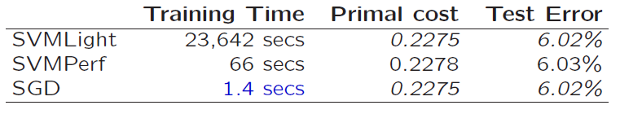
Example: Text categorization
Questions:
(1) Is SGD successful at minimizing f(w,b)?
(2) How quickly does SGD find the min of f(w,b)?
(3) What is the error on a test set?
Training time Value of f(w,b) Test error
Standard SVM “Fast SVM”
SGD SVM
(1) SGD-SVM is successful at minimizing the value of f(w,b)
(2) SGD-SVM is super fast
(3) SGD-SVM test set error is comparable

Slide 49
Spectral Decomposition
Used in PCA and spectral cluserting and manifold learning
Cost of eigendecomposition of an nxn matrix is O(n³)
Prohibitive for large data
Approaches:
Approximation
Acceleration

Slide 50
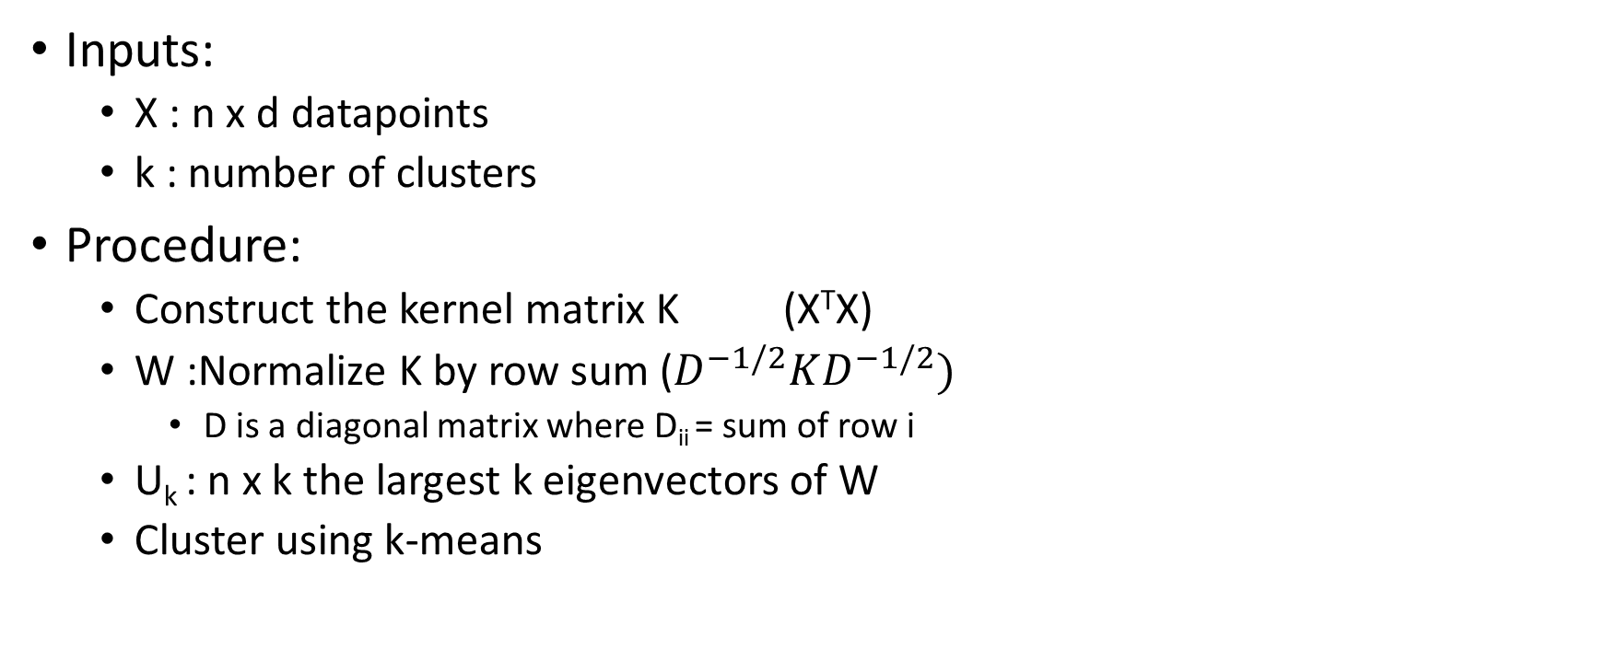
Spectral clustering in a nutshell
Inputs:
X : n x d datapoints
k : number of clusters
Procedure:
Construct the kernel matrix K (X^{T}X)
W :Normalize K by row sum ($D^{−1/2}KD^{−1/2})$
D is a diagonal matrix where D_{ii} = sum of row i
U_{k} : n x k the largest k eigenvectors of W
Cluster using k-means

Slide 51
Approximation
Nystrom methods:
Column subsampling of kernel matrices
Objective: reduce the size of data for SVD/eig needed to acquire an eigen-decomposition
Standard Nystrom
Variants:
Ensemble of Nystroms
OneShot Nystrom
Double Nystrom
Randomized Nystrom
..etc Nystrom

Slide 52
Standard Nystrom^{[1]}
Inputs
X_{nxd} :data points
m :sample size
k :rank (#eig vectors to retain)
Outputs
k approximate eigenpairs of the nxn kernel matrix

Slide 53
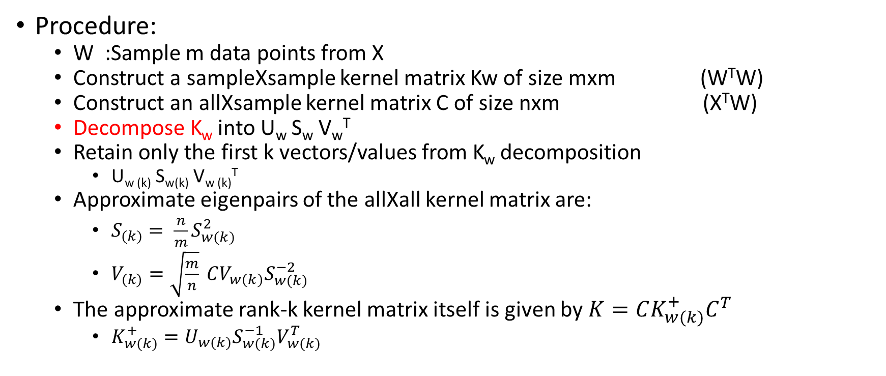
Standard Nystrom^{[1]} – cont’d
Procedure:
W :Sample m data points from X
Construct a sampleXsample kernel matrix Kw of size mxm (W^{T}W)
Construct an allXsample kernel matrix C of size nxm (X^{T}W)
Decompose K_{w} into U_{w} S_{w} V_{w}^{T}
Retain only the first k vectors/values from K_{w} decomposition
U_{w (k)} S_{w(k)} V_{w (k)}^{T}
Approximate eigenpairs of the allXall kernel matrix are:
$S_{(k)}= \frac{n}{m}S_{w(k)}^{2}$
$V_{(k)}=\sqrt{\frac{m}{n}} CV_{w(k)}S_{w(k)}^{−2}$
The approximate rank-k kernel matrix itself is given by $K=CK_{w(k)}^{+}C^{T}$
$K_{w(k)}^{+}=U_{w(k)}S_{w(k)}^{−1}V_{w(k)}^{T}$

Slide 54
Standard Nystrom^{[1]} – cont’d
Not very accurate approximation of rank k kernel matrix
The eigenvectors might not be orthogonal since they are only extrapolated from an mxm space
Ensemble of Nystroms^{[2]}:
Take more than one W sample
The final result is a linear combination of the individual results of the W’s
Randomized Nystrom^{[2]}:
Main idea: Use SSVD on Ensembles of Nystrom

Slide 55
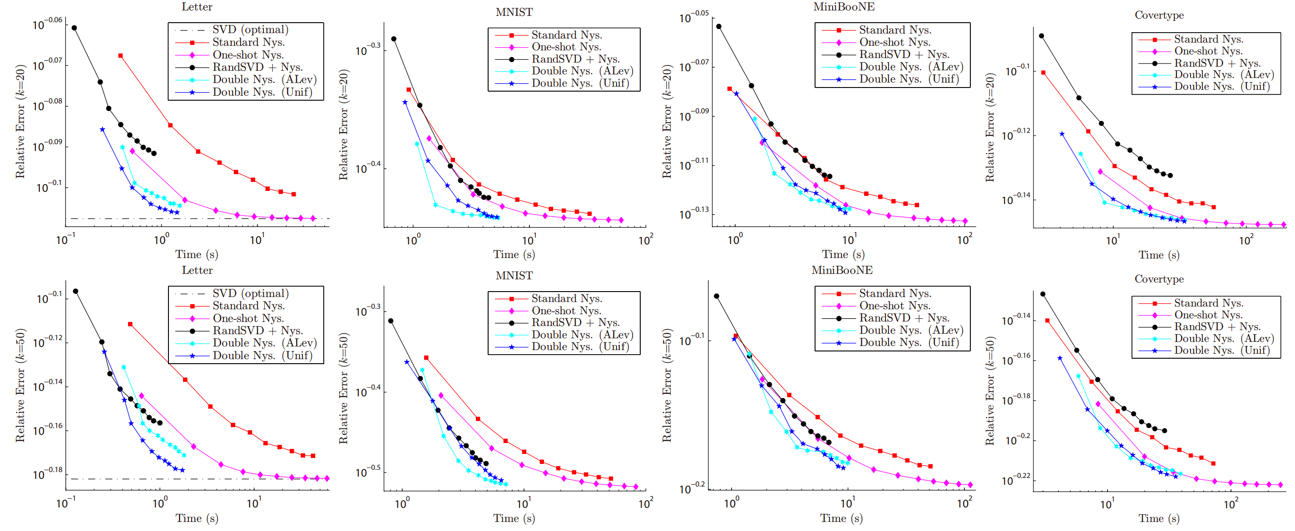
^{[1]}

Slide 56
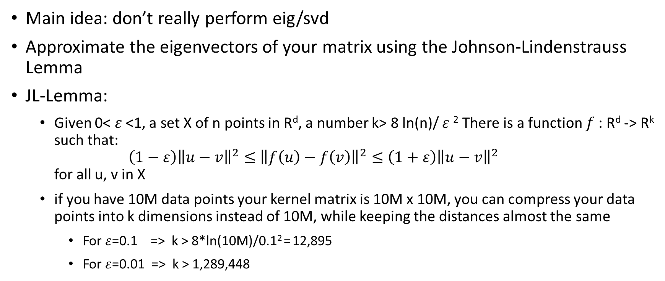
Approximation – Compressive Methods^{[3]}
Main idea: don’t really perform eig/svd
Approximate the eigenvectors of your matrix using the Johnson-Lindenstrauss Lemma
JL-Lemma:
Given 0< $ε$<1, a set X of n points in R^{d}, a number k> 8 ln(n)/ $ε$² There is a function $f$: R^{d} -> R^{k} such that: $\left(1−ε\right){\left\|u−v\right\|}^{2}≤{\left\|f\left(u\right)−f\left(v\right)\right\|}^{2}≤\left(1+ε\right){\left\|u−v\right\|}^{2}$ for all u, v in X
if you have 10M data points your kernel matrix is 10M x 10M, you can compress your data points into k dimensions instead of 10M, while keeping the distances almost the same
For $ε$=0.1 => k > 8*ln(10M)/0.1² = 12,895
For $ε$=0.01 => k > 1,289,448

Slide 57
Approximation - Compressive Methods^{[3]}
JL-Lemma can also be applied on “clusters”, to compress the number of data points needed to represent k clusters.
Since there are k clusters, k ln(k) datapoints are sufficient to represent them.
Thus, you only need to sample O(k ln(k)) datapoints, and interpolate the results back to all datapoints

Slide 58
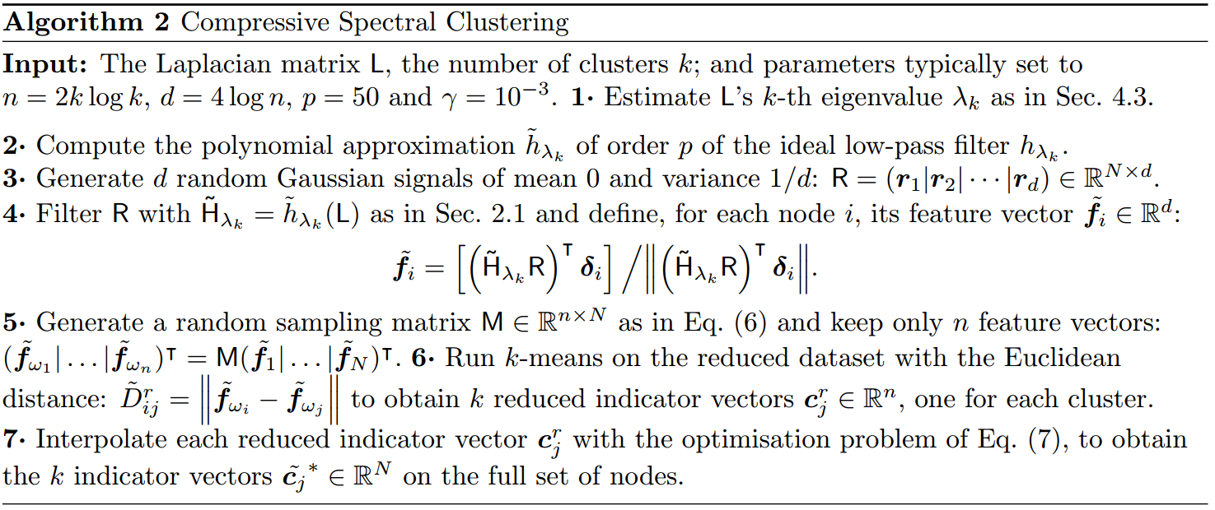
Compressive Spectral Clustering^{[3]}
The algorithm is designed around the Laplacian matrix, which is just Identiy - W, where W is the normalized kernel matrix in the briefly aforementioned spectral clustering algorithm. In this case we are looking for the smallest k-eigenvectors of L, which are equivalent to the largest k-eigenvectors of W. That’s why a low-pass filter is used, instead of a high-pass one

Slide 59
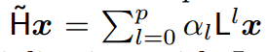
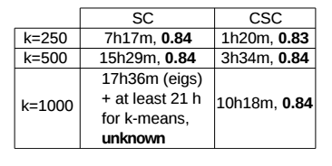
Compressive Spectral Clustering^{[3]}
The estimation of Low-rank Laplacian matrix of the dataset is done by constructing a polynomial approximation of applying a low pass filter on the singular values of the Laplacian matrix for some cut-off value.
The alpha constants are computed by approximating an ideal low-pass filter using a Jackson-Chebyshev polynomial
So it is really just a carefully cached power iteration so that the random vectors take over the shape of the “low-passed” eigenvectors of L
Think of a low-pass filter as just a function that only allows eigenvalues under some threshold to stay, and larger-than-threshold eigenvalues get zero’d; efficively zeroing the corresponding eigenvectors, thus achieving a low-rank approximation of the L matrix

Slide 60
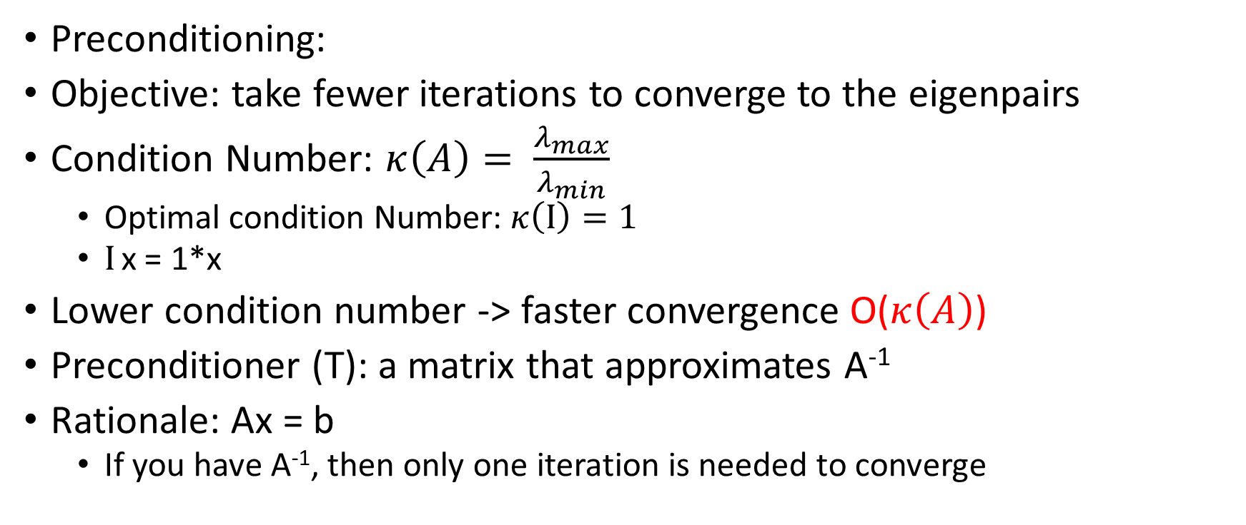
Acceleration
Preconditioning:
Objective: take fewer iterations to converge to the eigenpairs
Condition Number: $κ\left(A\right)= \frac{λ_{max}}{λ_{min}}$
Optimal condition Number: $κ\left(Ι\right)=1$
$Ι$ x = 1*x
Lower condition number -> faster convergence O($κ\left(A\right)$)
Preconditioner (T): a matrix that approximates A⁻¹
Rationale: Ax = b
If you have A⁻¹, then only one iteration is needed to converge

Slide 61
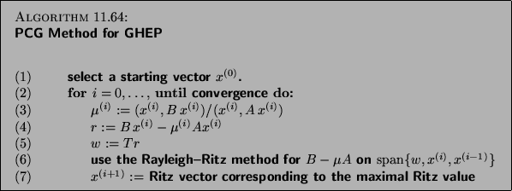
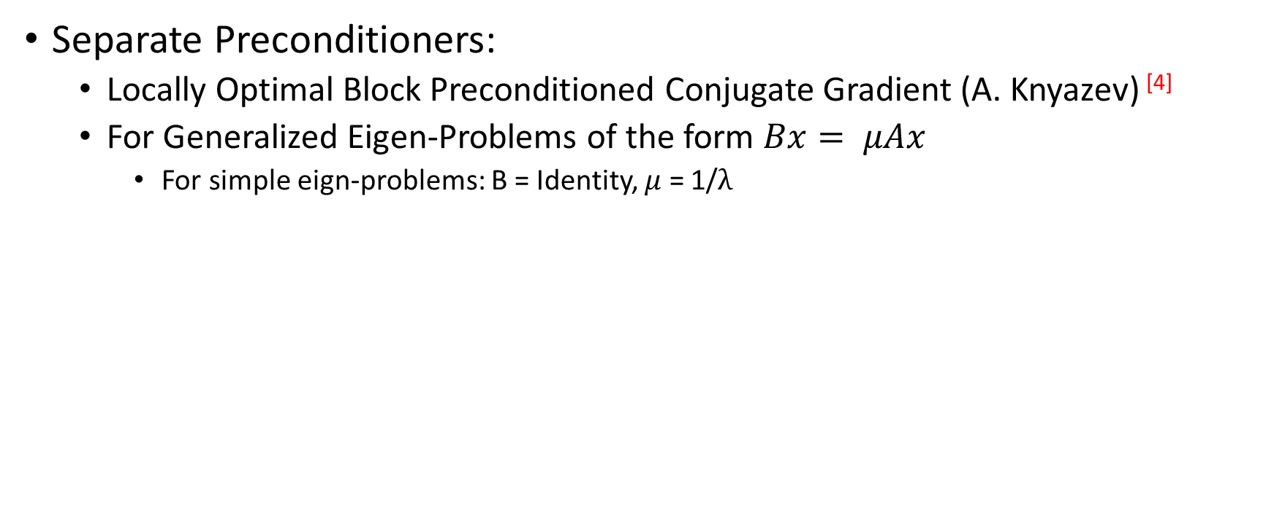
Preconditioned Solvers
Separate Preconditioners:
Locally Optimal Block Preconditioned Conjugate Gradient (A. Knyazev) ^{[4]}
For Generalized Eigen-Problems of the form $Bx= μAx$
For simple eign-problems: B = Identity, $μ$ = 1/$λ$

Slide 62
Separate Preconditioners
Several methods to acquire a preconditioner T, depending on the type of matrix A, and the potential condition number reduction.
Graph Sparsifiers:
Ramanujan expander graphs (D. Spielman): approximate any graph with only d*n/2 edges, where d is the degree of the expander graph, and n is the number of vertices
Finding low-stretch spanning trees
Matrix Sketching:
Frequent Directions (E. Liberty): Capture principal subspace of a streamed matrix, to approximate the original matrix
Multigrid Methods:
Coarsen your matrix until only a small number of points remain
Algebraic
Geometric

Slide 63
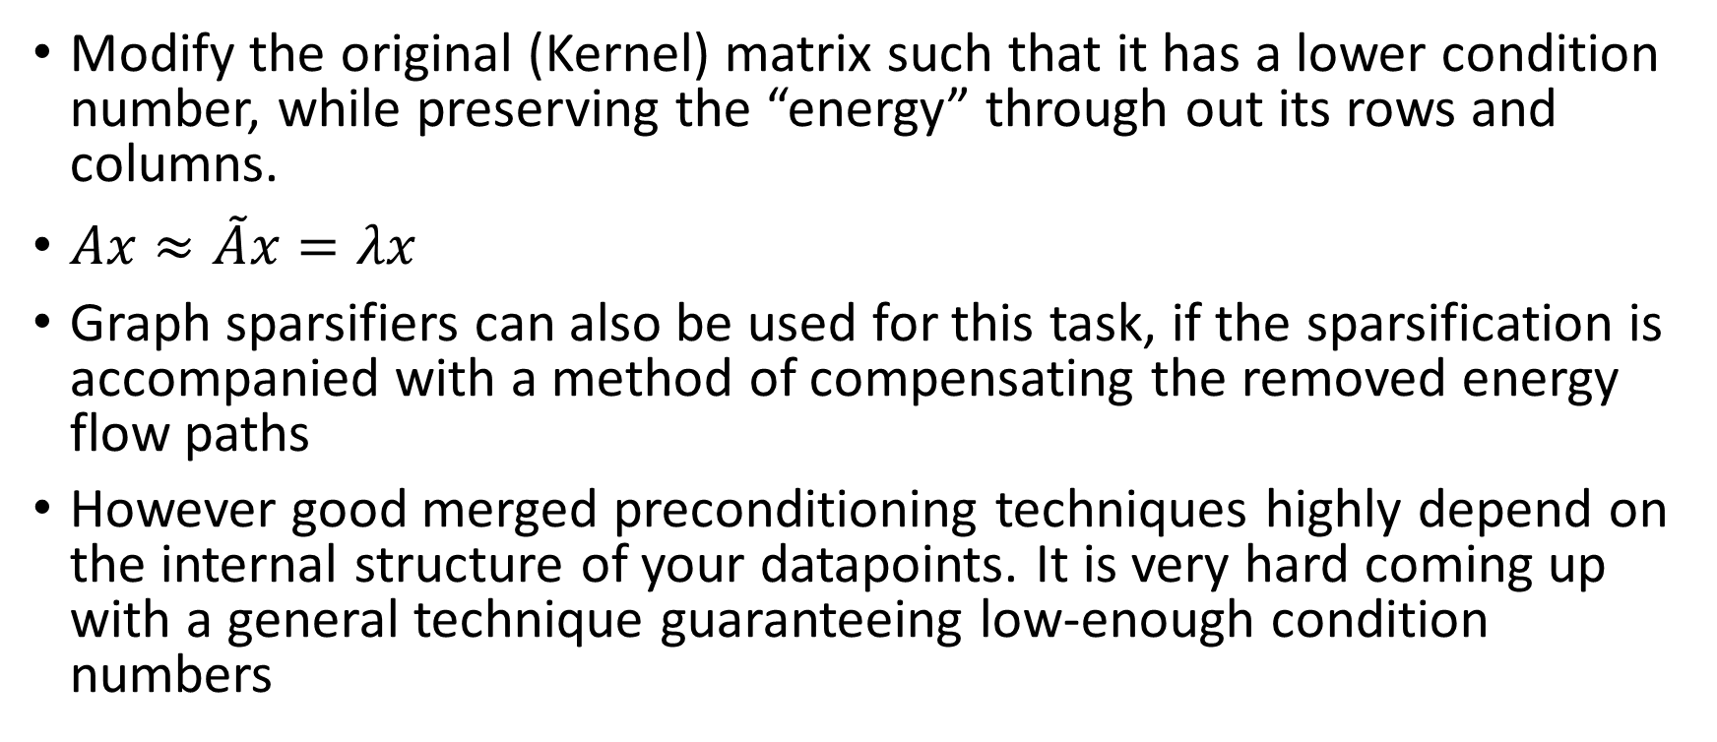
Merged Preconditioners^{eg, [5]}
Modify the original (Kernel) matrix such that it has a lower condition number, while preserving the “energy” through out its rows and columns.
$Ax≈\tilde{A}x=λx$
Graph sparsifiers can also be used for this task, if the sparsification is accompanied with a method of compensating the removed energy flow paths
However good merged preconditioning techniques highly depend on the internal structure of your datapoints. It is very hard coming up with a general technique guaranteeing low-enough condition numbers

Slide 64
References
[0]: Wikipedia
[1] Lim W. et al, “Double Nystrom Method: An Efficient and Accurate Nystrom Scheme for Large-Scale Data Sets”, Proceedings of the 32nd International Conference on Machine Learning, Lille, France, 2015. JMLR: W&CP volume 37.
[2] Mu Li; Wei Bi; Kwok, J.T.; Bao-Liang Lu, "Large-Scale Nyström Kernel Matrix Approximation Using Randomized SVD," in Neural Networks and Learning Systems, IEEE Transactions on , vol.26, no.1, pp.152-164, Jan. 2015.
[3] Tremblay N. et al, “Compressive Spectral Clustering”, Feb 2016, http://arxiv.org/abs/1602.02018
[4] http://www.netlib.org/utk/people/JackDongarra/etemplates/node418.html main stuff: http://math.ucdenver.edu/~aknyazev/research/eigensolvers/
[5] Krishnan, D. et al, “Efficient Preconditioning of Laplacian Matrices for Computer Graphics”, ACM Trans. Graph., vol.32, no.4, pp.142-156, July 2013.
[6] Hu, Y. et al. Collaborative Filtering for Implicit Feedback Datasets. ICDM08.
[7] Gemulla, R. et al. 2011. Large-scale matrix factorization with distributed stochastic gradient descent. In Proceedings of the 17th ACM SIGKDD international conference on Knowledge discovery and data mining (KDD '11). ACM, New York, NY, USA, 69-77. DOI=http://dx.doi.org/10.1145/2020408.2020426

